Slide 1

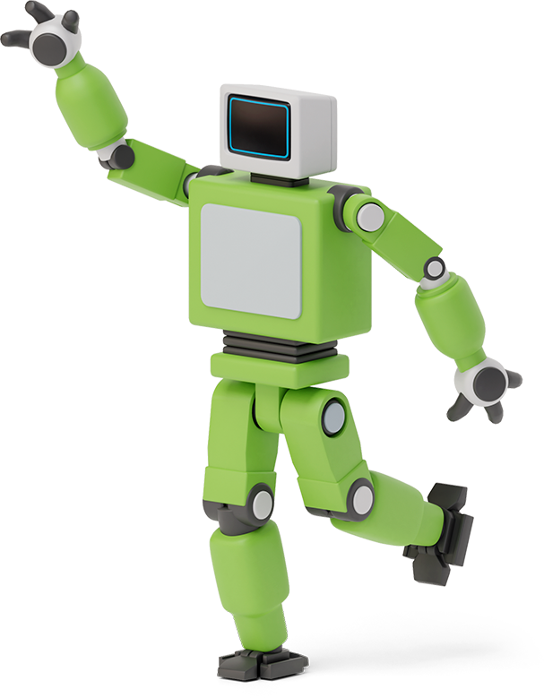


Github copilot

Slide 2

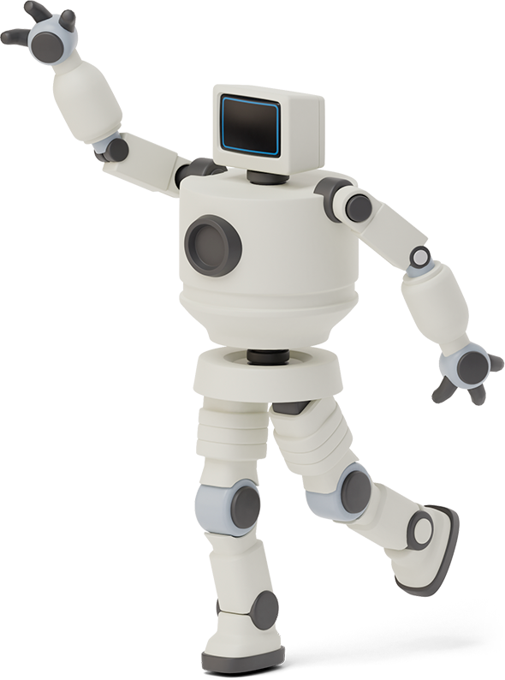

Hello!
I am Syed Javedhussain
Student ID: 720027410

Slide 3

What is github copilot ?
1
Your AI pair programmer

Slide 4
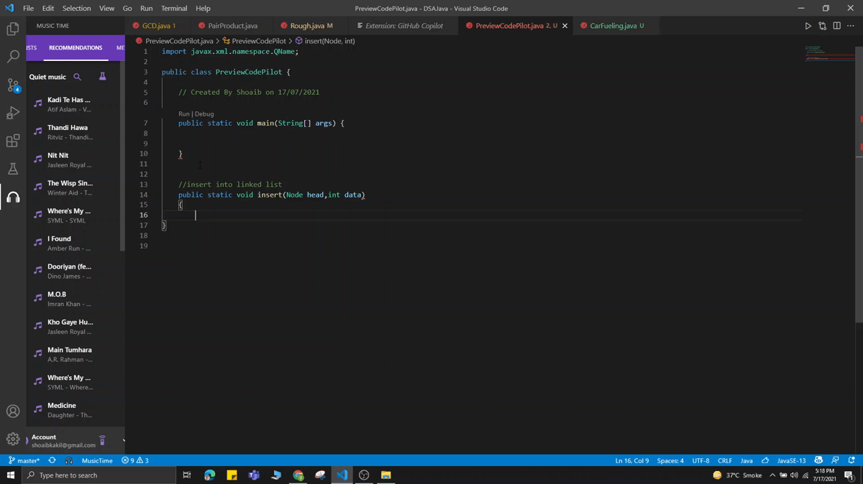
GitHub Copilot is an AI tool developed by GitHub and OpenAI to assist programmers to write code through autocompletion. The extension is made available for Visual Studio Code, Neovim, and JetBrains.
It’s a machine learning-powered software that can write code by itself, generating quite impressive programming functions.
The AI works similarly to other OpenAI-powered code-generating tools. The user writes a comment describing what they want the AI to write, and the AI makes it happen. What makes Copilot unique is that it also takes initiatives on its own, suggesting autocompletions on the fly.
According to Github, Copilot is powered by Codex, the new AI system created by OpenAI. GitHub Copilot understands significantly more context than most code assistants. Trained on billions of lines of public code, GitHub Copilot puts the knowledge you need at your fingertips, saving you time and helping you stay focused.
Three main features
1. Convert comments to code {
Github Copilot can understands bad comments and function names.
2. Test without the toil This is the only feature I would recommend you all to use in Github Copilot.
3. Autofill for repetitive code Github Copilot is the more advanced form of already available autosuggestion plugins.
}
¹

Slide 5
How does copilot work?
2
OpenAI Codex Model

Slide 6
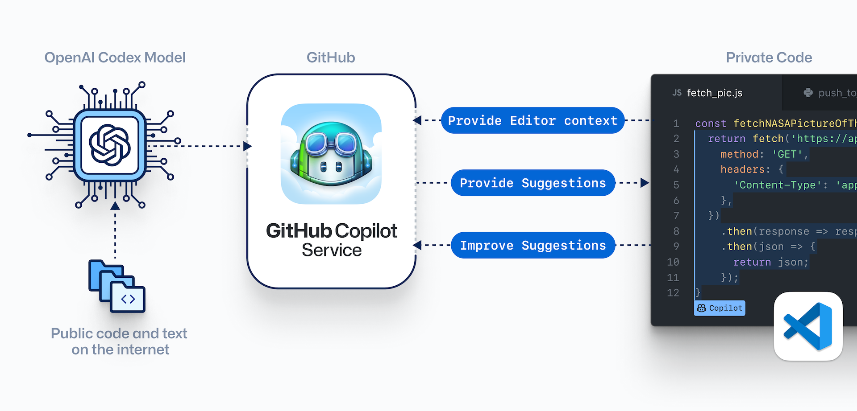
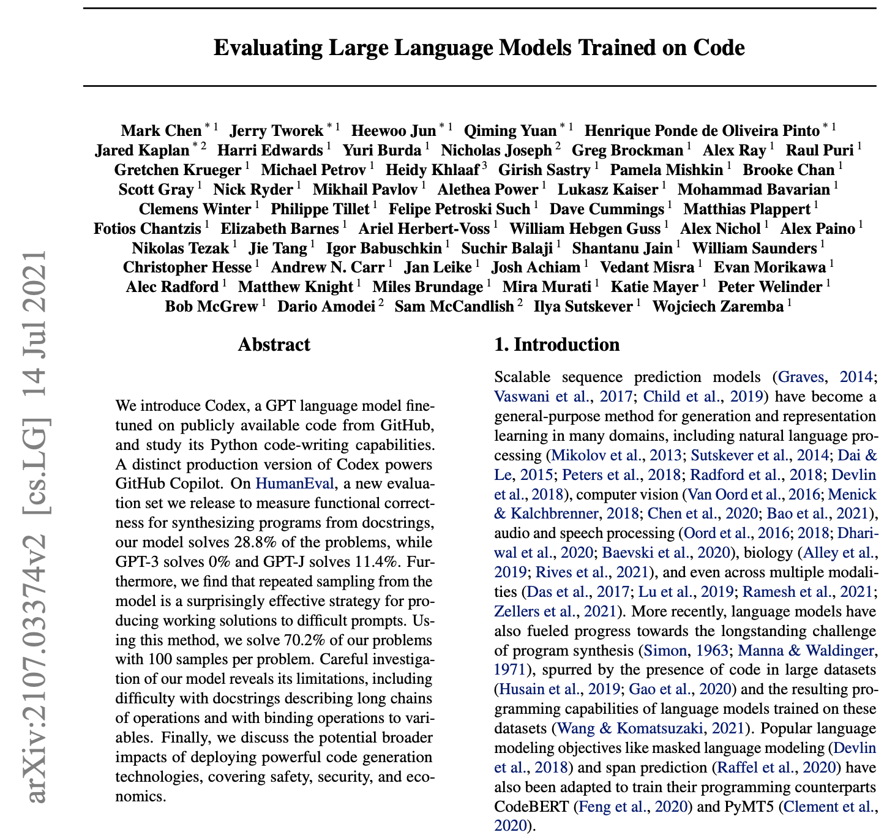
According to Github Copilot, it has been trained on a selection of English language and source code available on the internet including all Github repositories (except private repositories).
The working model speaks for itself. Coding-related text and available public code on the Internet (Github) is retrieved by Codex, which uses its algorithm and passes it on to the service Github Copilot. This service then provides suggestions for our private code, which is actually not private, as it sends suggestions for improvement back to the service Github Copilot.
According to the Codex paper, “Codex is a GPT language model fine-tuned on publicly available code from Github, and study its Python code-writing capabilities.” Codex is much more efficient and improved than GPT-3 because it's been trained on many public repositories available on Github.
This was all about the stats and facts of Codex, which is the backbone of Github Copilot. The paper clearly says that it will produce more accurate and effective results in the future, which means Github Copilot will become stronger and stronger.
²
Github Copilot Working Model
³

Slide 7

Causes and consequences ?
3
Weak Security and Fraud

Slide 8
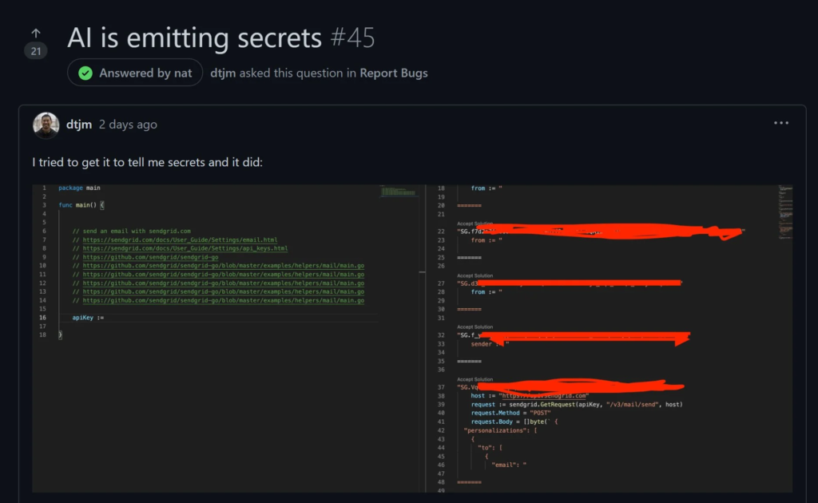
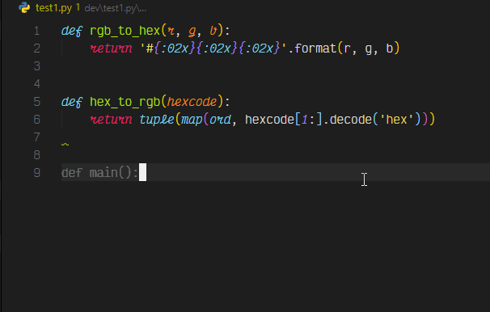
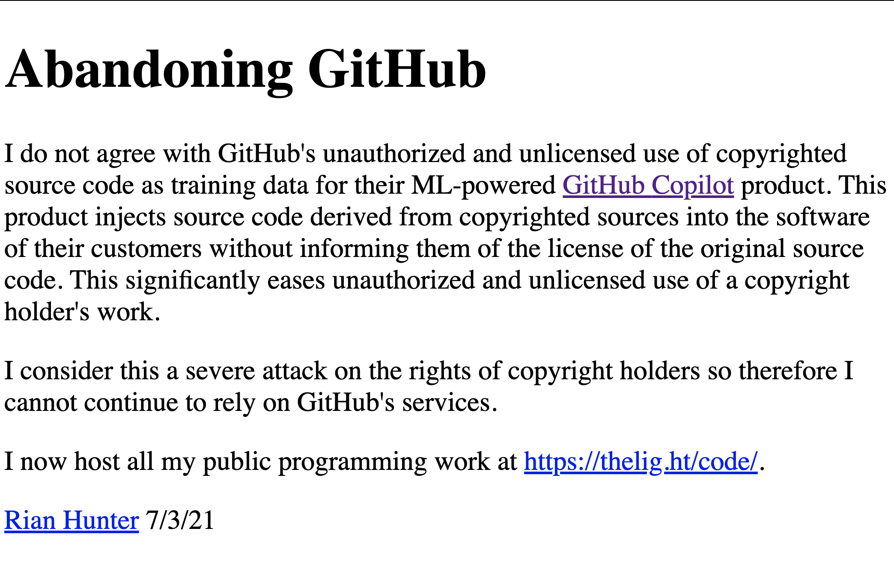
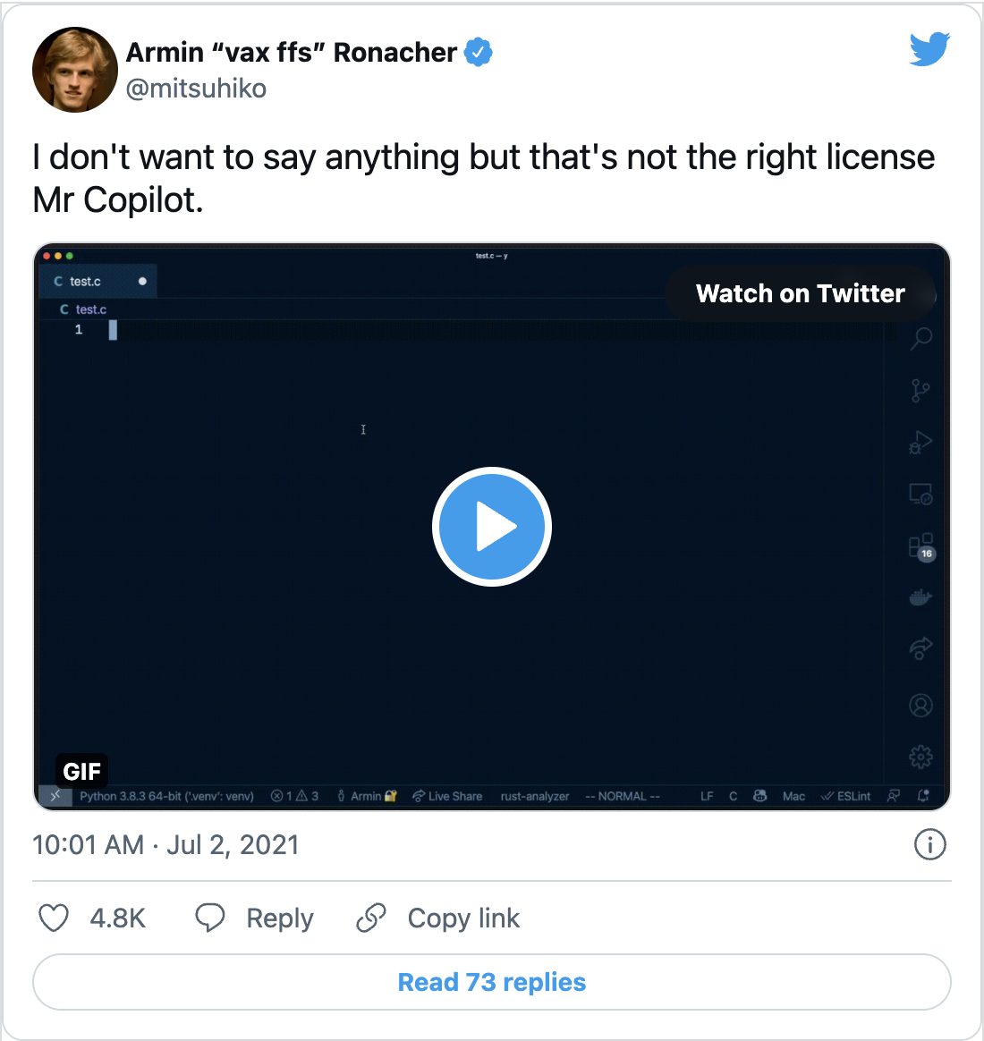
CoPilot looks and feels like Microsoft’s all-time effort to improve Intellisense, its code-completion IDE plugin. However, this time the completion is actually writing complete code bodies instead of completing keywords. Apparently, this effort was made possible by applying modern ML models, provided by OpenAI’s GPT-3 models, on GitHub public data, at a massive scale.
According to the chatter on Reddit and Twitter, it seems that this data had not been triaged first. This means that artifacts like secrets and copyrighted code are being suggested as completion options. Which is very, very bad. We can see this happening right now. It was first reported by Sam Nguyen, a SendGrid engineer (djtm on GitHub):
As per Armin Ronacher (creator of Flask reports as we can also reproduce copyrighted code.)
We can't say that as GitHub Copilot tries to understand your intent and to generate the best code it can, but the code it suggests may not always work or even make sense. While developers are working hard to make GitHub Copilot better, code suggested by GitHub Copilot should be carefully tested, reviewed, and vetted, like any other code.
In its FAQ, GitHub claims that “[…] the code you create with GitHub Copilot’s help belongs to you.” However, on popular programmer site Hacker News, people are arguing that Copilot is infringing copyright. The AI should only be allowed to use code that its initial owners have made available for commercial use, yet it’s clearly using all manners of code, regardless of licenses.
In another thread on Hacker News, people are expressing concerns that using the tool might get you sued, as you might unknowingly use copyrighted code. One user calls Copilot a “legal ticking time bomb,” while another adds a personal anecdote: “I run product security for a large enterprise, and I’ve already gotten the ball rolling on prohibiting copilot […].”
This has all proven enough for some to abandon GitHub.
⁵
⁶
⁴

Slide 9

FAQ
4
Critical Reflection

Slide 10
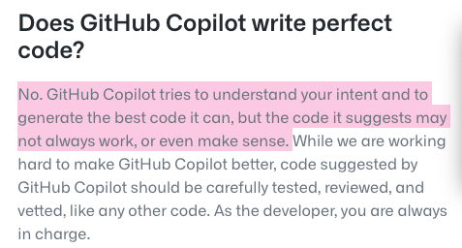
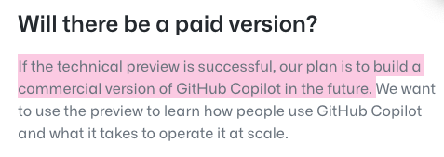
How AI tools will impact developers
Github Copilot will greatly increase developer productivity. It will also help reduce the cost of software production. I think Github Copilot could replace writing code (programmers), but it will take more than enough time to replace developers in the first place I use two different titles—programmer and developer—because the Bureau of Labor Statistics (BLS) classifies computer programmers and software developers separately, with developers being paid higher than programmers because they have more tasks indirectly related to writing and interacting with code.
So it's more of a Smart Suggester. And that's why they call it a copilot, right? It's not the pilot. It's a copilot. So when we talk about this, there's probably responsibility. Copilot autocompletes code snippets, suggests new lines of code, and can even write whole functions based on the description provided. It will make things easy for developers, that's it.
Should we use Github Copilot?
My experience with Github Copilot is not that good. As the paper claims that Codex has solved more than 10,000 Competitive programming problems, I was solving a Bit Strings problem. Github Copilot suggested some very awkward statements that had nothing to do with the if-logic, which means Copilot has to learn a lot. I used Copilot just to test, but using AI tools in Competitive Programming is CHEATING ON YOURSELF.
It Is Free Now, but Later You Have To Pay
High Potential To Produce Bad and Unsafe Code
⁸
⁷

Slide 11
Competitor Matrix
HIGH VALUE 2
Kite
Tabnine
LOW VALUE 1
HIGH VALUE 1
GPT-Code-Clippy
Second Mate
Asm-Dude
Captain Stack
Clara
LOW VALUE 2

Slide 12
bibliography
5
References

Slide 13
References
https://copilot.github.com/
https://copilot.github.com/diagram.png
https://arxiv.org/abs/2107.03374
https://twitter.com/mitsuhiko/status/1410886329924194309?ref_src=twsrc%5Etfw%7Ctwcamp%5Etweetembed%7Ctwterm%5E1410886329924194309%7Ctwgr%5E%7Ctwcon%5Es1_&ref_url=https%3A%2F%2Fsecurityboulevard.com%2F2021%2F07%2Fthe-dangers-of-ai-ml-in-code-githubs-copilot-leak%2F
https://news.ycombinator.com/item?id=27676266
https://twitter.com/carnage4life/status/1411564496707981319
https://docs.github.com/en/github/copilot
https://docs.github.com/en/github/copilot

Slide 14
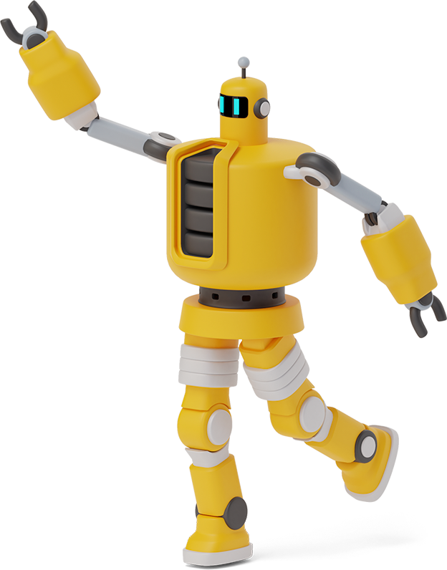
Thanks!
Any questions? You can find me at:
Syed
sj565@exeter.ac.uk

